Slide 1
EFFICIENCY+
Enhancing Operational Efficiency in Clinical Trials
ASA Biopharmaceutical Section /// Scientific Working Group (SWG)
July 10, 2025
Mission
  Enhance operational efficiency in clinical trials through statistical innovation and cross-functional collaborative research

Slide 2
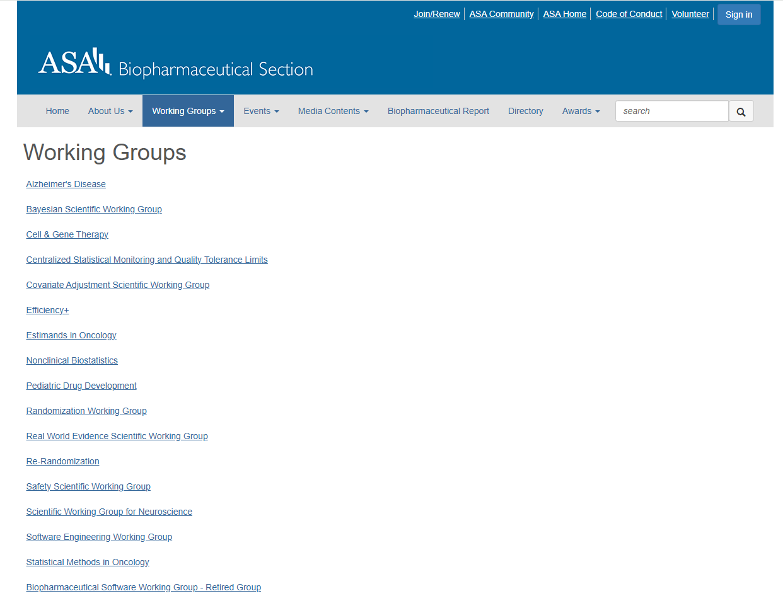
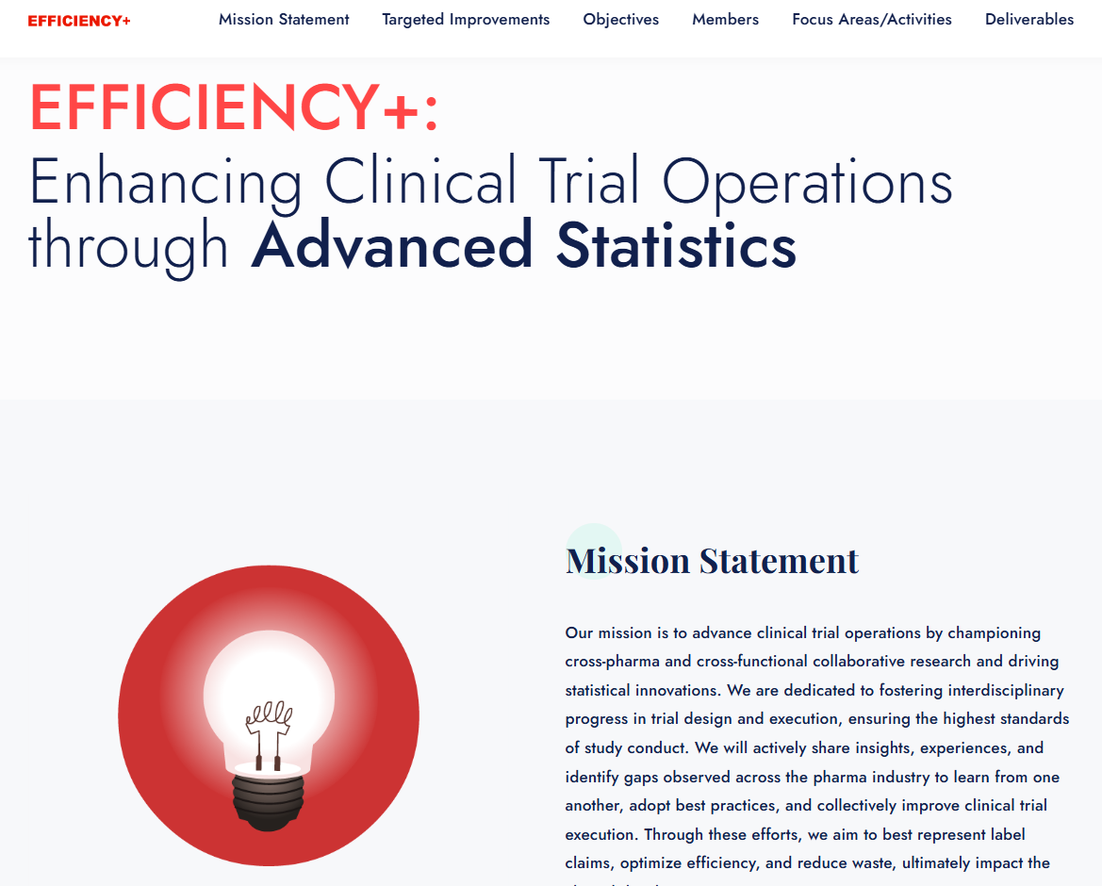
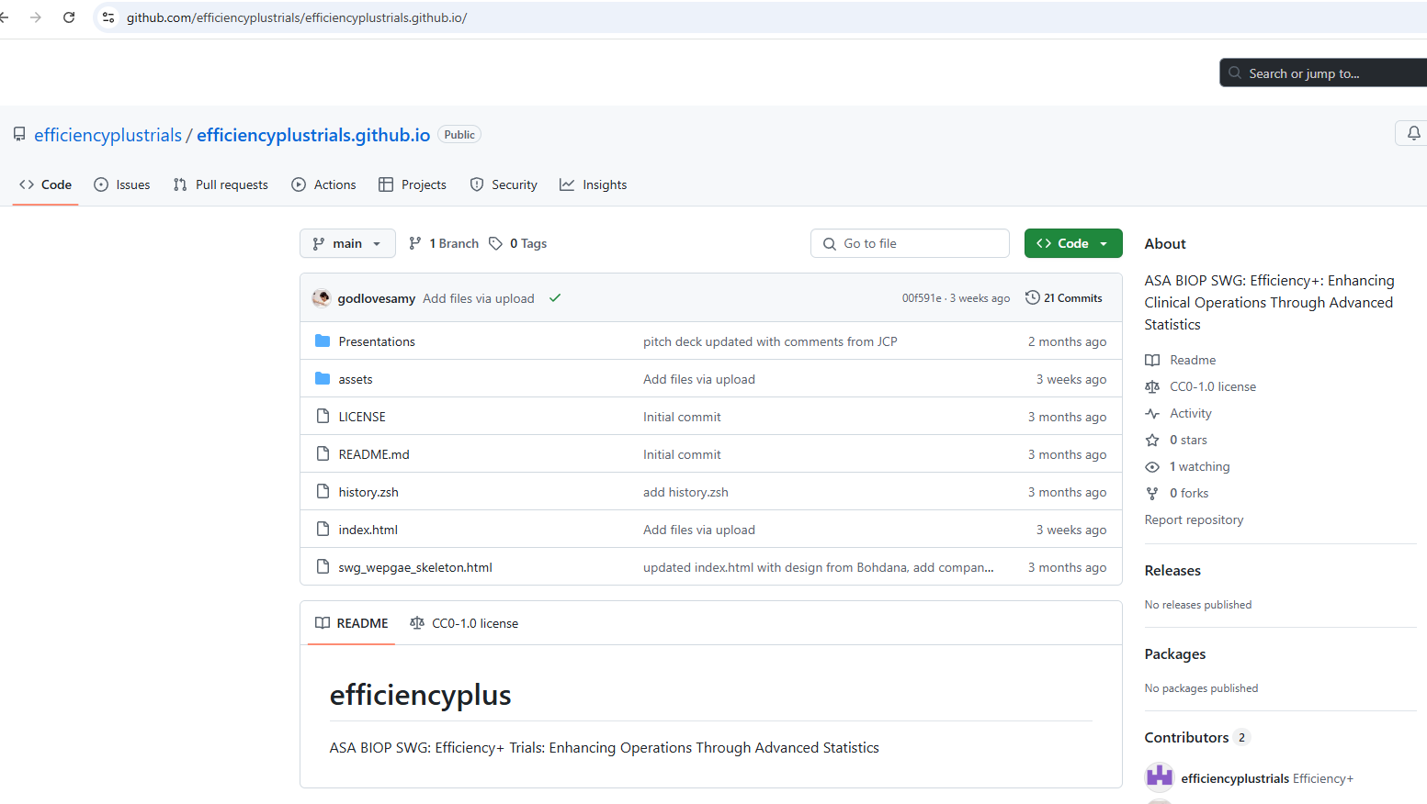
New ASA BIOP SWG
Link: Biopharmaceutical Section of the American Statistical Association - Biopharmaceutical Section
Link: GitHub - efficiencyplustrials/efficiencyplustrials.github.io: ASA BIOP SWG: Efficiency+: Enhancing Clinical Operations Through Advanced Statistics

Slide 3
Initial Targets for SWG Membership
Initial Member Profiles
Statisticians
Clinical operations professionals
Data scientists
Desired expertise
Bayesian modeling
Predictive modeling, AI/ML
Clinical trial simulations
Data visualization
Data science and software tools development
Clinical drug supply optimization

Slide 4
Sponsors (and other companies) collaborating in this initiative
AbbVie
Amgen
AstraZeneca
Bayer
Bristol Myers Squibb
Beonemed
Cytel
Lilly
Regeneron
Sanofi
Boehringer Ingelheim
Johnson & Johnson

Slide 5
Focus Areas
Patient Recruitment Monitoring and Forecasting, and Site Selection
Study Design and Operations Impact
Dynamic Trial Monitoring and Data Quality
Clinical Supply Chain

Slide 6
Primary Goals of Efficiency+
Create a collaborative platform for statisticians, clinical operational experts, and regulators
Facilitate the exchange of insights, experiences, and best practices
Identify, evaluate, develop, and promote statistical methods and operational strategies to improve the efficiency of clinical trial execution, including:
  Leveraging innovative methodologies such as Bayesian modeling, Data Science and AI/ML, clinical trial simulation, and data visualization
  Leveraging real-world and clinical trial data

Slide 7
Activities and Timeline
Year 1
Literature review
Year 2
Develop and apply methodologies
Year 3
Publish findings
Identify key inefficiencies
Summarize existing methodologies and tools
Propose methodological improvements
Conduct case studies
Develop recommendations
Present at conferences
Promote best practices across the industry
Explore potential collaborations with other related SWGs

